Slide 1
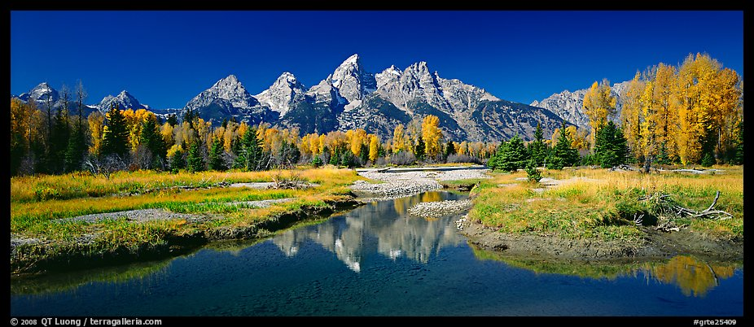
Evaluation of revised Uniform Rate of progress goalS for western United states
Alternative title slide
Ralph Morris and Ou Nopmongcol, Ramboll Environ
Zac Adelman, University of North Carolina
Tom Moore, WESTAR/WRAP
Control #116
Presented at A&WMA Visibility Conference
Jackson Hole, Wyoming
September 27-30, 2016
Notes:
Alternative title slide. Image size: 8 cm x 25,4 cm or 302 x 960 pixels

Slide 2
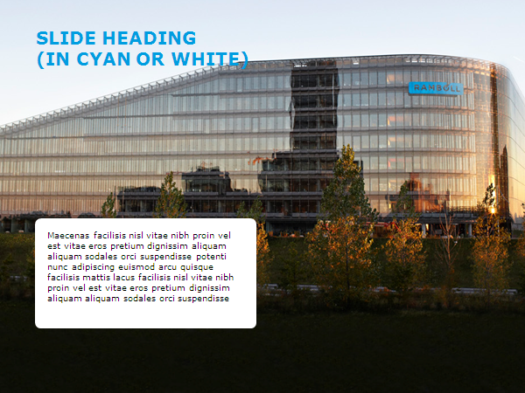
Content
Recent Western Regional Air Partnership (WRAP) Modeling
Develop the next generation regional air quality modeling databases for air quality planning in western states
2008 West-wide Jump-Start Air Quality Modeling Study (WestJumpAQMS)
2011 Western Air Quality Study (WAQS)
Intermountain West Data Warehouse (IWDW)
WAQS 2011 Photochemical Grid Model (PGM) Modeling
CAMx/CMAQ PGM Modeling Databases
2011 Model Performance Evaluation
2025 Future-Year Modeling
Using WRAP/WAQS/IWDW 2008 and 2011 Modeling Data to Evaluate new Regional Haze Metrics
Baseline Worst/Most Impaired 20% Days
2064 Natural Conditions Goal
Full slide image with white fact box
Notes:
Full slide image with white fact box

Slide 3
Recent wrap regional modeling studies
WRAP WestJumpAQMS
Develop CAMx 2008 36/12/4 km platform
2008 Ozone and PM Source Apportionment
Western Air Quality Study (WAQS)
Develop 2011 CMAQ/CAMx 2011 36/12/4 km platform
2011 ozone and PM Source Apportionment
2011 Clean U.S. Background (USB) Simulations
Transfer 2008 and 2011 modeling databases to Intermountain West Data Warehouse (IWDW)

Slide 4
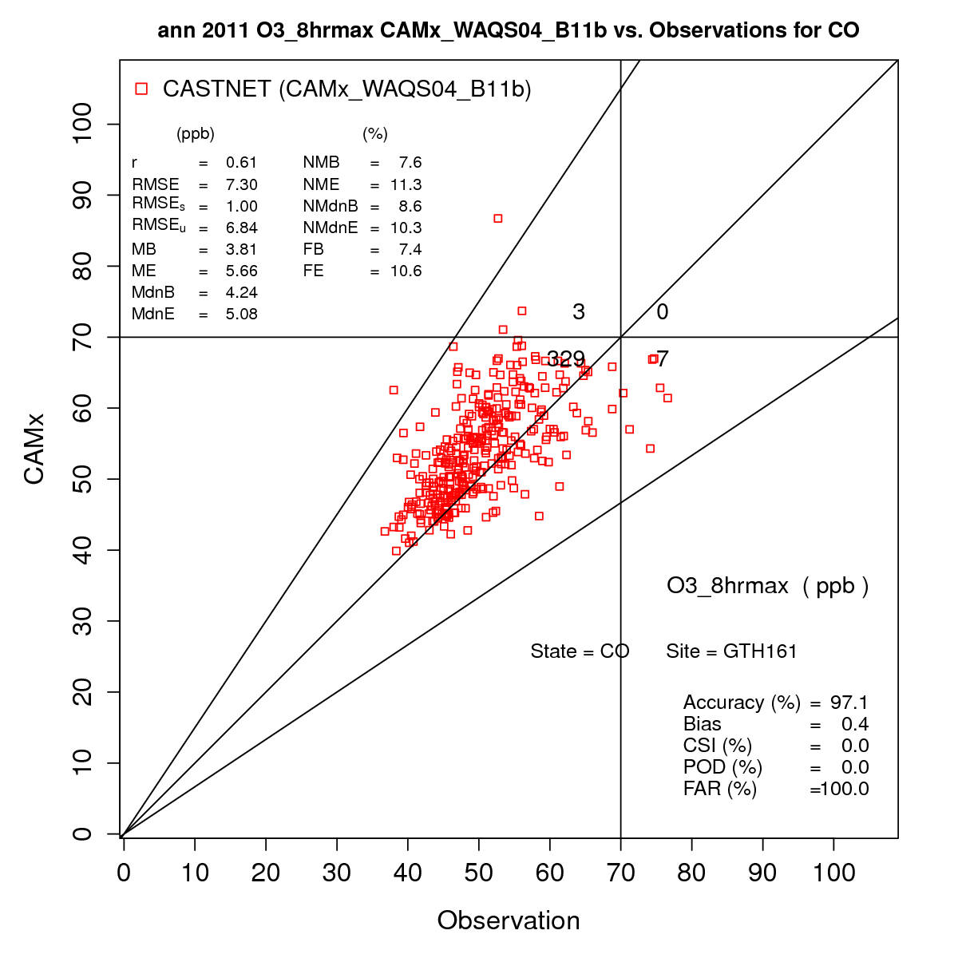
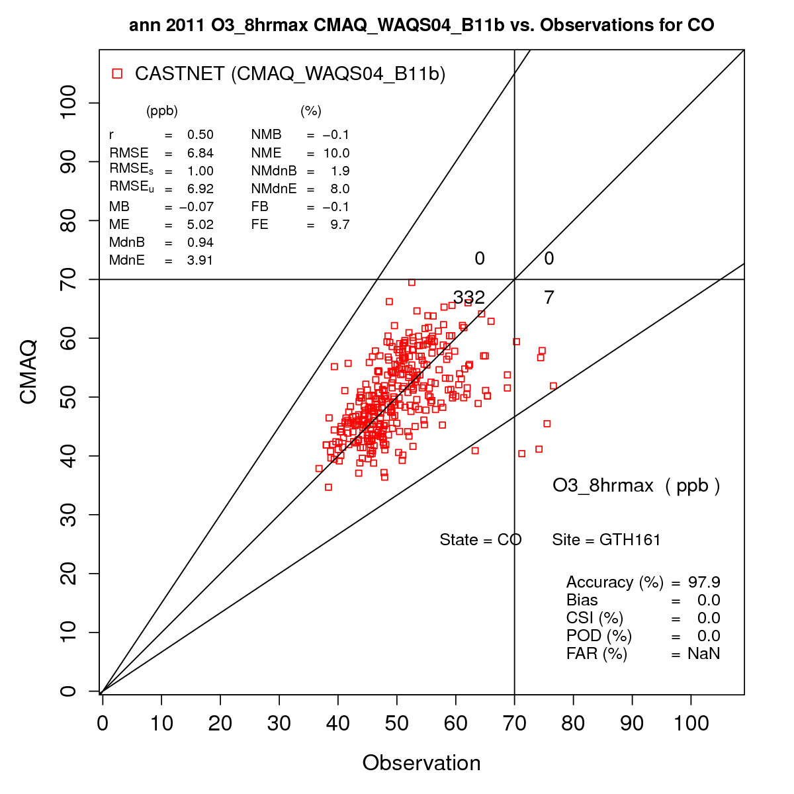
WRAP Western Air Quality Study (WAQS)
O3 Goals
NMB ≤±15%
NME ≤35%
2011 WRF Meteorological Model
2011 CMAQ/CAMx 36/12/4 km
Model Performance Evaluation
2025 CMAQ/CAMx 36/12/4 km
2011 O3 & PM Source Apportionment Modeling
State-Specific
Source Sector-Specific
Clean Simulations (USB)
PM_{2.5} MPE @ 31 IMPROVE Sites
CAMx
NMB = 7.6%
NME = 11.3%
CMAQ
NMB = =0.1%
NME = 10.0%

Slide 5
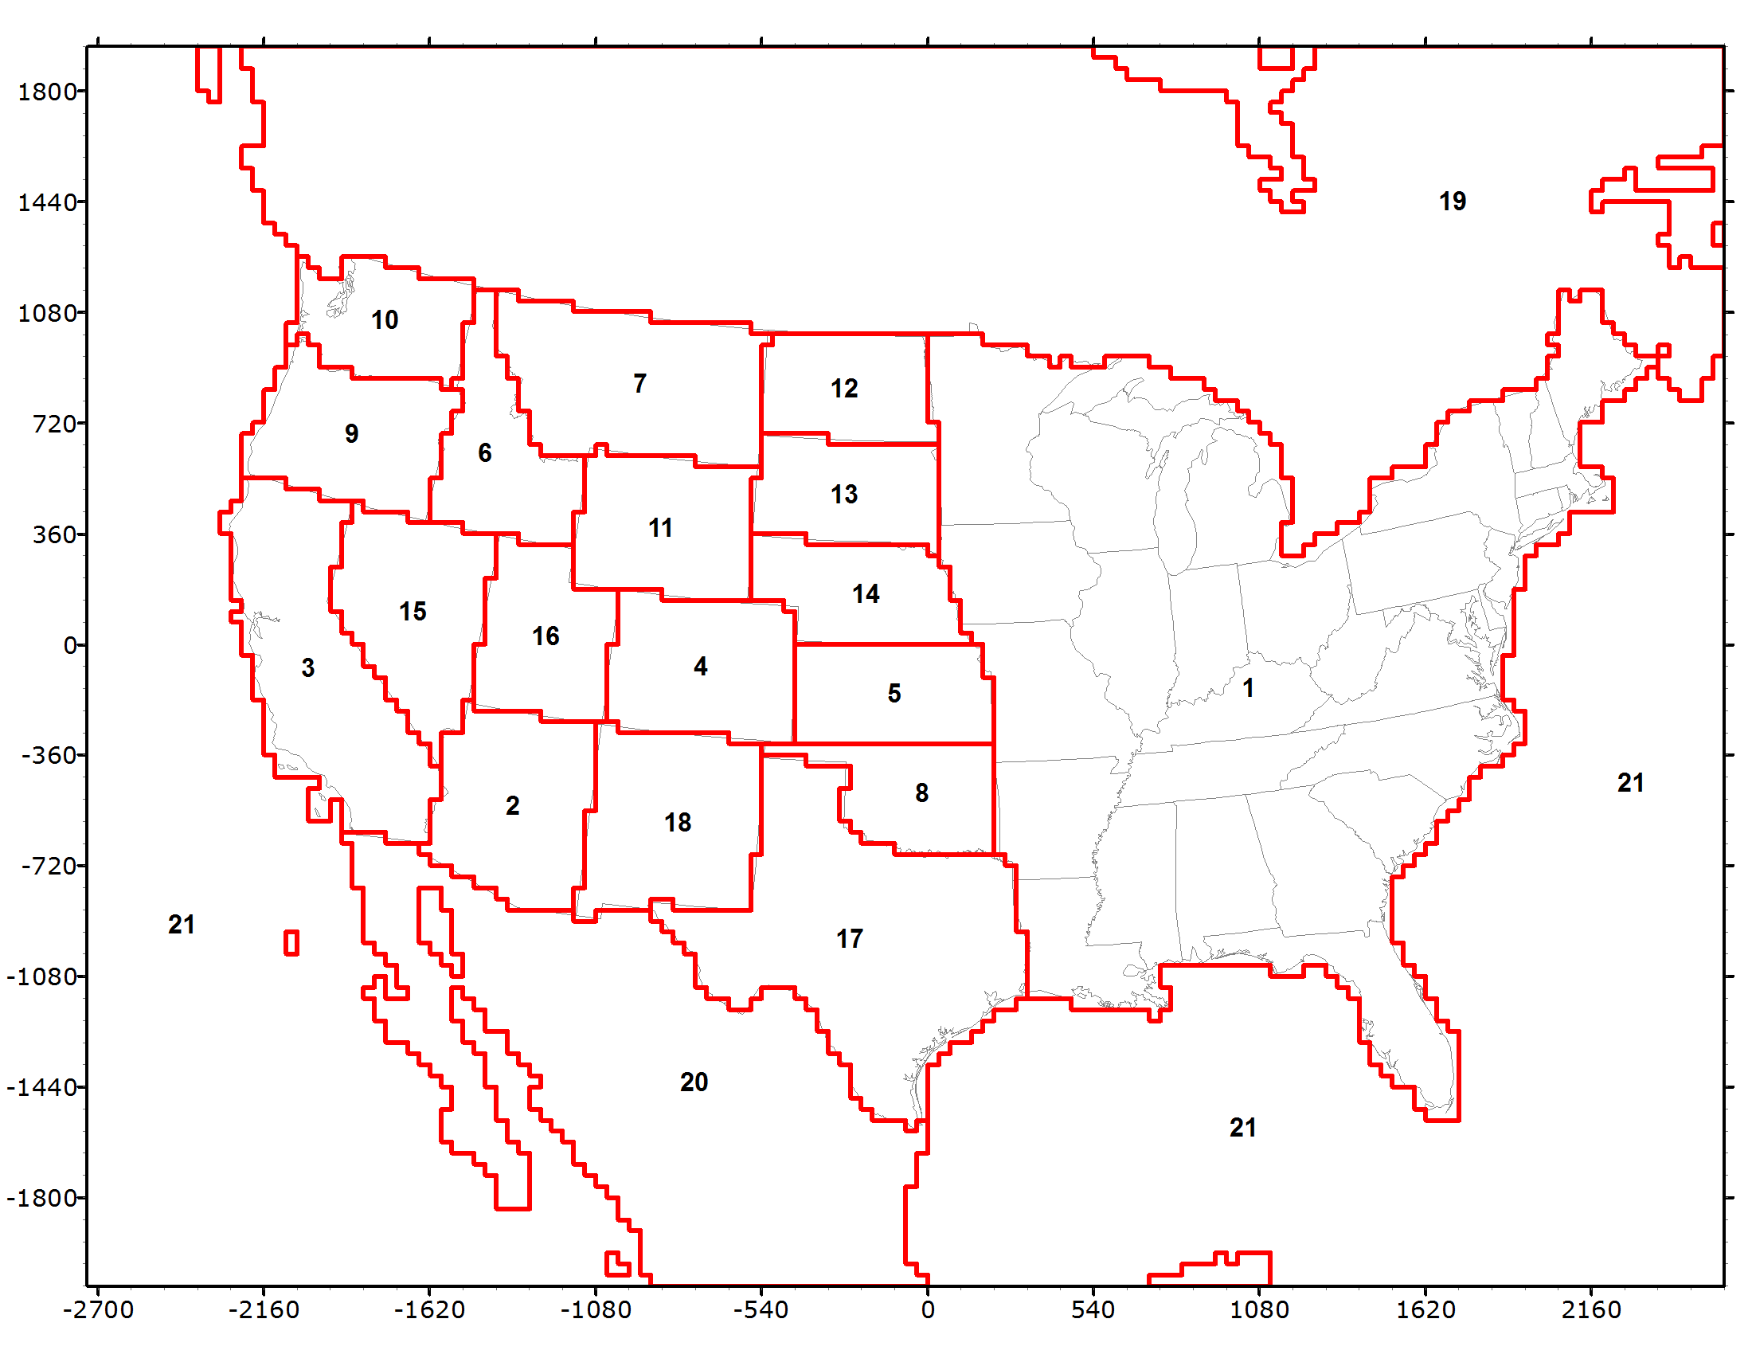
WAQS 2011 State-Specific Source Apportionment Visibility Analysis
PSAT PM Source Apportionment
21 Geographic Regions
17 Western States + EUSA
Mex, Can, Off-shore
Five Source Categories
Natural (Bio, LNOx, SS, WBD)
Wildfire
Prescribed Burns
Agricultural Burning
Anthropogenic
Initial Concentrations
Boundary Conditions (CONUS)
Same configuration as used in WestJumpAQMS State-Specific PSAR Source Apportionment

Slide 6
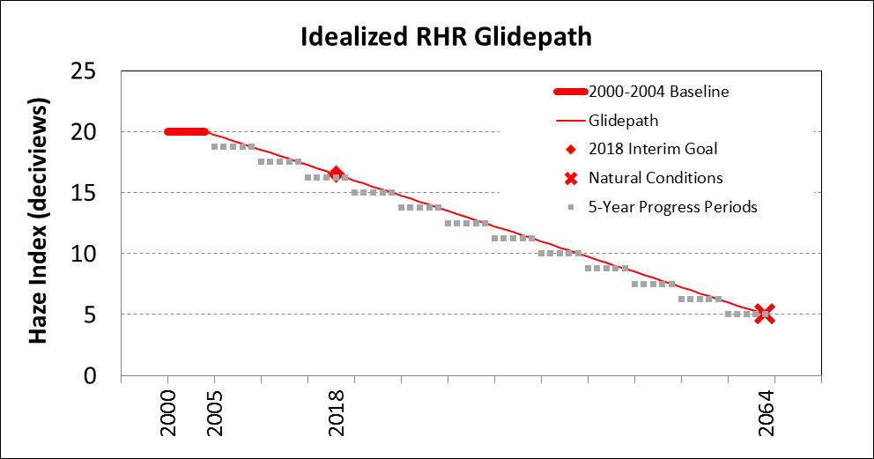
Use WAQS PM Source Apportionment data in URP Glide Path Evaluation
How to define 2000-2004 Baseline based on measured IMPROVE?
W20%; EPA Most Impaired; PSAT W20%; PSAT Most Impaired
How to define 2064 Natural Conditions?
NCII; EPA guidance; PSAT Uncontrollable; US Background Runs
Baseline
Natural
Conditions

Slide 7
WAQS 2011/2008 Visibility Analysis – Evaluation of Alternative Glide Paths
Extract PSAT concentrations results at IMPROVE sites in CONUS domain and apply IMPROVE extinction equation
Separate visibility extinction contributions into Controllable and Uncontrollable sources
Controllable Sources
U.S. Anthropogenic Emissions
Uncontrollable Sources:
Natural (Biogenic, Lightning NO_{X}, Windblown Dust, Sea Salt, Ocean DMS)
Open Land Fires (Wild fires, Prescribed Burns and Agricultural Burning)
International Transport
Mexico and Canada in CONUS Domain
MOZART GCM CONUS Boundary Conditions (BCs)

Slide 8
WAQS 2011/2008 Visibility Analysis – Evaluation of Alternative Glide Paths
Apply day-specific and site-specific PSAT modeled Controllable and Uncontrollable extinction fractions to IMPROVE measured extinction by species
Use CAMx PSAT day-specific species-specific visibility extinction modeling results in relative fashion to apportionment measured 24-hour IMPROVE data
Identify PSAT 20% Most Impaired Days
Days with highest U.S. man-made emission contribution
Develop Glide Paths from the PSAT Most Impaired Days to Natural Conditions in 2064
What 2064 Natural Conditions should be used, evaluated two approaches:
Modeled PSAT Uncontrollable Extinction from Base Case
U.S. Background Simulations (no U.S. anthropogenic emissions)

Slide 9
2008 Yellowstone IMPROVE and PSAT 24-hour visibility extinction

Slide 10
Yellowstone -- 2008 PSAT Separate improve extinction into controllable/uncontrollable

Slide 11
2011 Yellowstone IMPROVE and PSAT 24-hour visibility extinction

Slide 12
Yellowstone -- 2011 PSAT Separate improve extinction into controllable/uncontrollable

Slide 13
NATURAL CONDITIONS – USE WAQS Clean U. S. Background (USB) simulations
Three CAMx 2011 36 km CONUS simulations with no U.S. anthropogenic emissions using Boundary Conditions (BC) from three different Global Chemistry Models (GCMs):
MOZART (MZBC)
GEOS-Chem (GCBC)
AM3 (AMBC)
Compare three USB modeling results with EPA’s 2016 visibility background estimates (2064 goal)
Note: EPA Natural Background does not include international anthropogenic emissions but model USB simulations do
i.e., includes Mex/Can Anthro in CONUS domain plus Intl Anthro in GCM BCs
Need GCM simulations with no global anthropogenic emissions for apple-to-apple comparisons

Slide 14
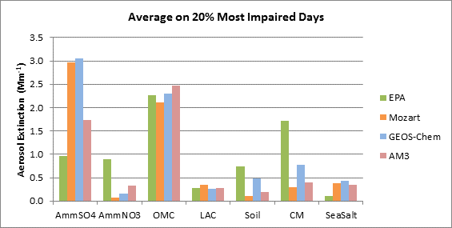
Comparison of EPA Natural background with model USB estimates

Slide 15
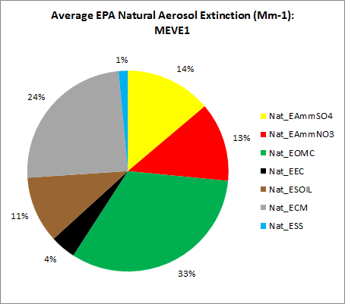
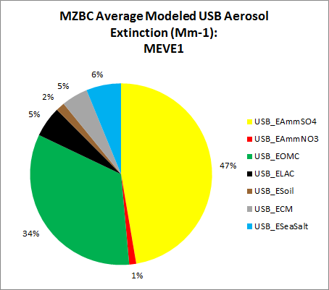
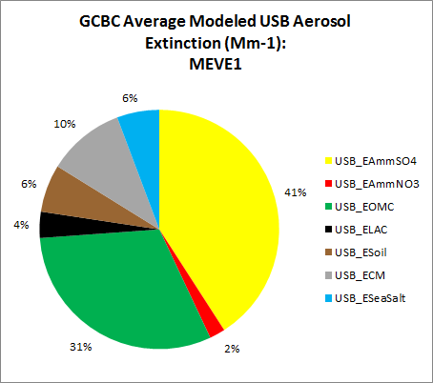
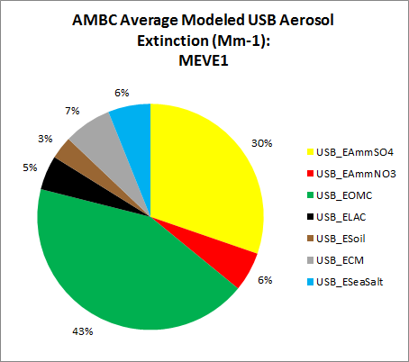
Percent contribution to natural background extinction by species

Slide 16
Conclusions EPA NATURAL vs. model U.S. background comparisons
USB much higher SO4 than EPA BCK
~3x MZBC and GCMZ and ~2x AMBC
Asia SO2 emissions in USB simulations?
USB NO3 lower than EPA
Related to higher model USB SO4?
USB OMC/OA/OC greater than EPA in summer and less in winter, although average across most impaired days very similar
Model has more SOA?
Need zero anthropogenic emissions GCM BCs with PGM North American Background (NAB) simulations for direct comparison with EPA Natural Background
Zero global anthropogenic emissions

Slide 17
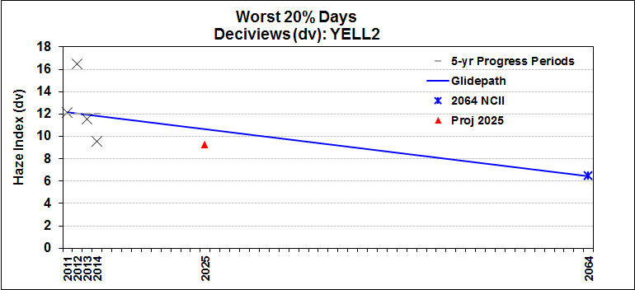
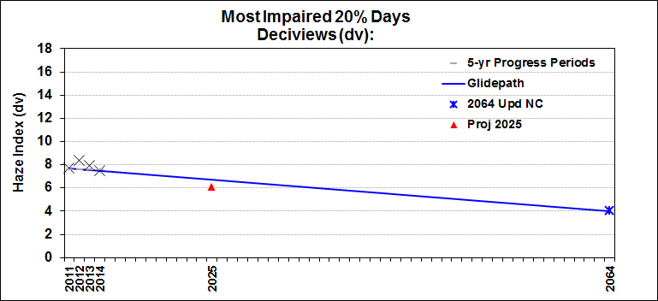
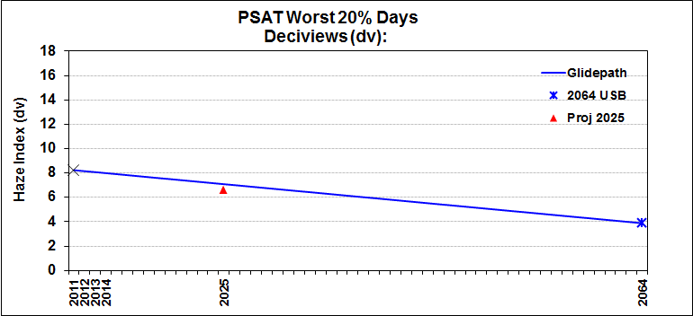
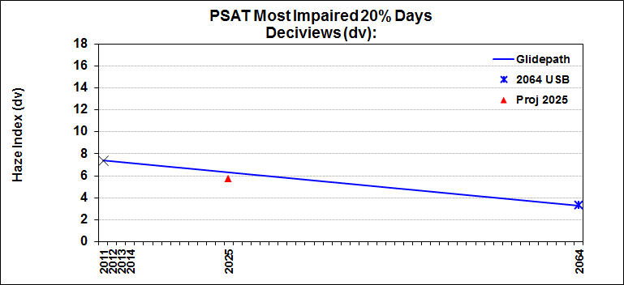
Example Yellowstone Glide Paths and 2025 projections using 4 approaches (more details provided Thursday)
W20%
EPA Most Impaired
PSAT W20%
PSAT Most Impaired

Slide 18
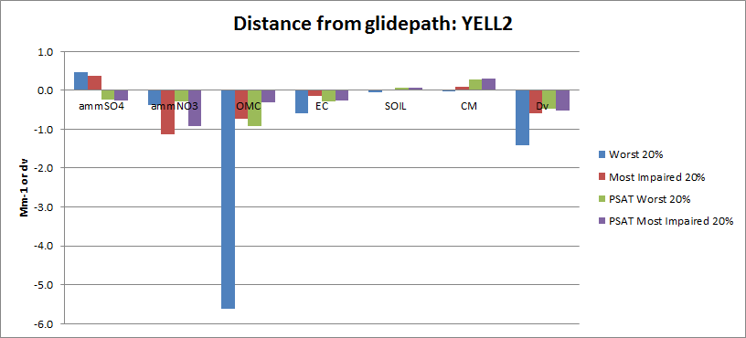
Difference between 2025 model and 2025 URP glide path in extinction (mm⁻¹)
Yellowstone NP
PSAT sees large SO4 from BCs (international)
Model NO3 more responsive for Most Impaired vs. W20% days
For OMC, model misses some observed WF days using W20% metric
Model missing large WBD events in IMPROVE data

Slide 19
Additional talks on visibility glide paths (Baseline/natural) and modeling
Wed 11:00 – Conceptual Approach to Address Anthropogenic/Non-Anthropogenic Emissions for More Accurate Glide Path – Ou Nopmongcol, Ramboll Environ
Thurs 10:20 – Source Attribution for Visibility Planning using a Regional Photochemical Model – Patricia Brewer, NPS
Thurs 10:40 – The Uniform Rate of Progress and Setting Reasonable Progress Goal in Western U.S. Class I federal areas – Gail Tonnesen, EPA Region 8
Thurs 11:00 – Assessment of Contributions to Visibility Impairment in Western United States and Effects of New Guidance for Tracking Visibility Progress – Ralph Morris, Ramboll Environ

Slide 20
Thank you
End slide
Notes:
Endslide

